Slide 1
Dependencies in DBMS

Slide 2
Dependency
A dependency occurs in a database when information stored in the same database table uniquely determines other information stored in the same table.

Slide 3
Functional Dependency
A functional dependency is defined as a constraint between two sets of attributes in a relation from a database.
Given a relation R, a set of attributes X in R is said to functionally determine another attribute Y, also in R, (written X → Y) if and only if each X value is associated with at most one Y value.

Slide 4
An attribute is functionally dependent on another if we can use the value of one attribute to determine the value of another.
We use the arrow symbol → to indicate a functional dependency. X → Y is read X functionally determines Y
X is the determinant set and Y is the dependent attribute. Thus, given a tuple and the values of the attributes in X, one can determine the corresponding value of the Y attribute.

Slide 5
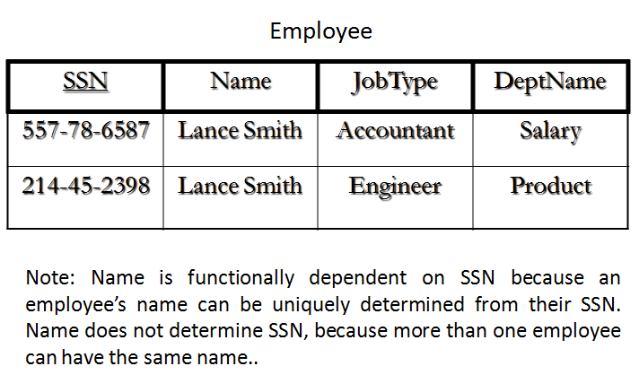
Example

Slide 6
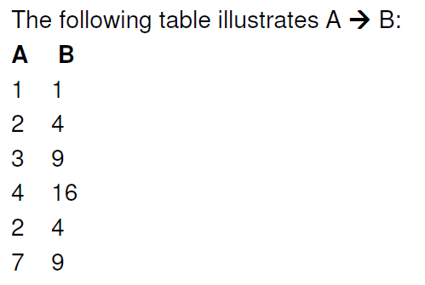
Functional Dependence (FD)

Slide 7
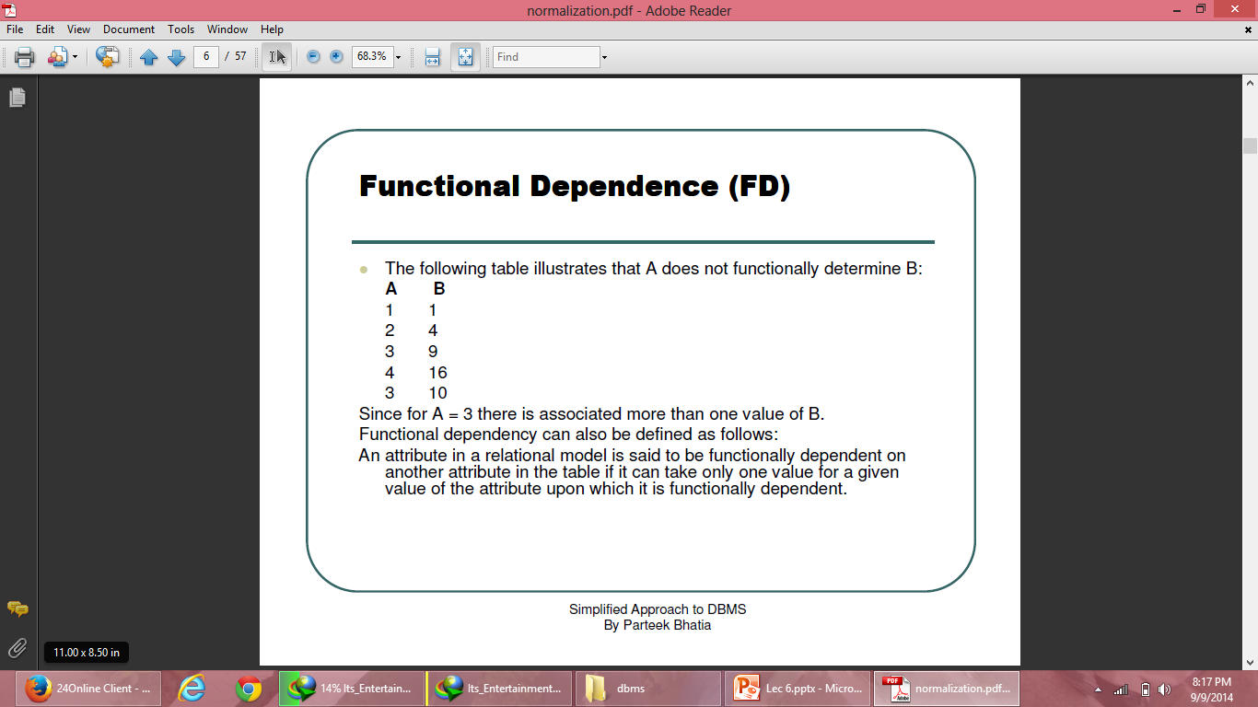
Functional Dependence (FD)

Slide 8
Partial functional dependency
In a relation R(A,B,C,D) if the key is (A,B) and
(A,B)->(C,D) holds, also (A)->(C) also holds, C is said to be partially dependent on (A,B)
Partial Functional Dependency occurs only in relation with composite keys. Partial functional dependency occurs when one or more non key attribute are depending on a part of the primary key.

Slide 9
Example
Table: Stud_id, Course_id, Stud_name, Course_Name
Where: Primary Key = Stud_id + Course_id
Then: To determine name of student we use only Stud_id, which is part of primary key.
{Stud_id} -> {Stud_Name}
Hence,Stud_name is partially dependent on Stud_id. This is called partial dependency.

Slide 10
Fully functional dependency
In R(A,B,C) if (A,B)->C holds and
neither A->C nor B->C holds then it s fully functionally dependent on (A,B).
A functional dependency X → Y is a full functional dependency if removal of any attribute A from X means that the dependency does not hold any more

Slide 11
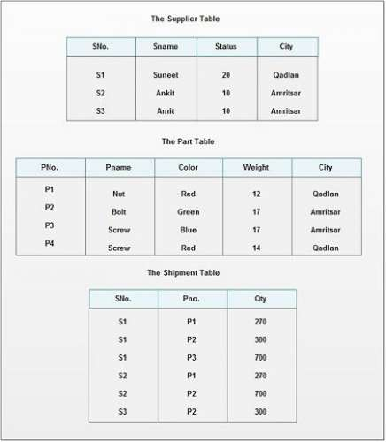

Slide 12
For example, in relation Supplier, different cities may have the same status. It may be possible that cities like Amritsar, Jalandhar may have the same status 10.
So, the City is not FD on Status.
But, the combination of Sno, Status can give only one corresponding City because “Sno” is unique. Thus,
(Sno, Status) City
It means city is FD on composite attribute (Sno, Status) however City is not fully functional dependent on this composite attribute, which is explained below:
(Sno, Status) City
X Y
Here Y is FD on X, but X has two proper subsets Sno and Status; city is FD on one proper subset of X i.e. Sno
Sno City
According to FFD definition, Y must not be FD on any proper subset of X, but here City is FD in one subset of X i.e. Sno, so City is not FFD on (Sno, Status)

Slide 13
Consider another case of SP table:
Here, Qty is FD on combination of Sno, Pno.
(Sno, Pno) Qty
X Y
Here, X has two proper subsets Sno and Pno
Qty is not FD on Sno, because one Sno can supply more than one quantity.
Qty is also not FD on Pno, because one Pno may be supplied many times by different suppliers with different or same quantities.
So, Qty is FFD on (Sno, Pno) .

Slide 14
Transitive Functional Dependency
A Transitive Functional Dependency is a functional dependency where the determinant and the determined both consists of non-key attributes.
X→ Y
X non-prime attribute
Y also non prime attribute

Slide 15
Trivial Functional Dependency
Trivial: If an FD X → Y holds where Y subset of X, then it is called a trivial FD. Trivial FDs always hold.
Non-trivial: If an FD X → Y holds where Y is not subset of X, then it is called non-trivial FD.

Slide 16
Armstrong’s Axiom Rules
Armstrong axioms consist of the following following rules:
Primary rules
Reflexivity: If Y ⊆ X, then X → Y.
Augmentation: If X → Y , then XZ → YZ.
Transitivity: If X → Y and Y → Z, then X → Z.

Slide 17
Secondary rules
Union If A holds B and A holds C, then A holds BC. If{A → B} and {A → C}, then {A → BC}
Decomposition If A holds BC and A holds B, then A holds C. If{A → BC} and {A → B}, then {A → C}
Pseudo Transitivity If A holds B and BC holds D, then AC holds D. If{A → B} and {BC → D}, then {AC → D}

Slide 18
Example 1
Consider relation E = (P, Q, R, S, T, U) having set of Functional Dependencies (FD).
P → Q P → R QR → S Q → T QR → U PR → U
Calculate some members of Axioms as follows:

Slide 19
1. P → T In the above FD set, P → Q and Q → T So, Using Transitive Rule: If {A → B} and {B → C}, then {A → C} ∴ If P → Q and Q → T, then P → T. P → T

Slide 20
2. PR → S In the above FD set, P → Q As, QR → S So, Using Pseudo Transitivity Rule: If{A → B} and {BC → D}, then {AC → D} ∴ If P → Q and QR → S, then PR → S. PR → S

Slide 21
3. QR → SU In above FD set, QR → S and QR → U So, Using Union Rule: If{A → B} and {A → C}, then {A → BC} ∴ If QR → S and QR → U, then QR → SU. QR → SU

Slide 22
4. PR → SU So, Using Union Rule: If{A → B} and {A → C}, then {A → BC} ∴ If PR → S and PR → U, then PR → SU. PR → SU

Slide 23
How to check whether an FD can be derived from a given FD set?
To check whether an FD A->B can be derived from an FD set F,
Find (A)+ using FD set F.
If B is subset of (A)+, then A->B is true else not true.

Slide 24
Example 2
In a schema with attributes A, B, C, D and E following set of functional dependencies are given {A -> B, A -> C, CD -> E, B -> D, E -> A} Which of the following functional dependencies is NOT implied by the above set?
A. CD -> AC B. BD -> CD C. BC -> CD D. AC -> BC

Slide 25
Answer: Using FD set given in question, (CD)+ = {CDEAB} which means CD -> AC also holds true. (BD)+ = {BD} which means BD -> CD can’t hold true. So this FD is no implied in FD set. So (B) is the required option. Others can be checked in the same way.
(BC)+ ={B,C,D,E,A} which means BC -> CD also holds true.
(AC)+ ={A,C,B,D,E} which means AC -> BC also holds true.

Slide 26
How to find Candidate Keys and Super Keys using Attribute Closure?
If attribute closure of an attribute set contains all attributes of relation, the attribute set will be super key of the relation.
If no subset of this attribute set can functionally determine all attributes of the relation, the set will be candidate key as well.
Note: Candidate key is the minimal super key

Slide 27
Example 3
Consider the relation scheme R = {E, F, G, H, I, J, K, L, M, N} and the set of functional dependencies {{E, F} -> {G}, {F} -> {I, J}, {E, H} -> {K, L}, K -> {M}, L -> {N} on R. What is the candidate key for R?
A. {E, F} B. {E, F, H} C. {E, F, H, K, L} D. {E}

Slide 28
Finding attribute closure of all given options, we get: {E,F}+ = {EFGIJ} {E,F,H}+ = {EFHGIJKLMN} {E,F,H,K,L}+ = {EFHGIJKLMN} {E}+ = {E} {EFH}+ and {EFHKL}+ results in set of all attributes, but EFH is minimal. So it will be candidate key. So correct option is (B).

Slide 29
Example 4
Consider a relation scheme R = (A, B, C, D, E, H) on which the following functional dependencies hold: {A–>B, BC–> D, E–>C, D–>A}. What are the candidate keys of R?
(a) AE, BE (b) AE, BE, DE (c) AEH, BEH, BCH (d) AEH, BEH, DEH

Slide 30
Answer: (AE)+ = {ABECD} which is not set of all attributes. So AE is not a candidate key. Hence option A and B are wrong. (AEH)+ = {ABCDEH} (BEH)+ = {BEHCDA} (BCH)+ = {BCHDA} which is not set of all attributes. So BCH is not a candidate key. Hence option C is wrong. So correct answer is D.

